Slide 1
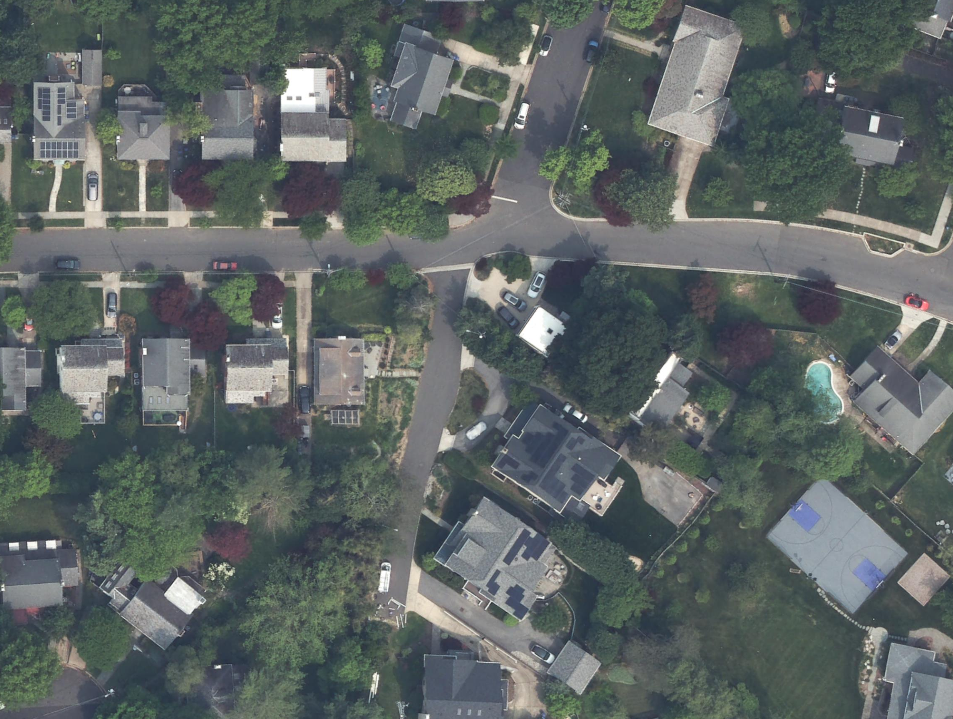
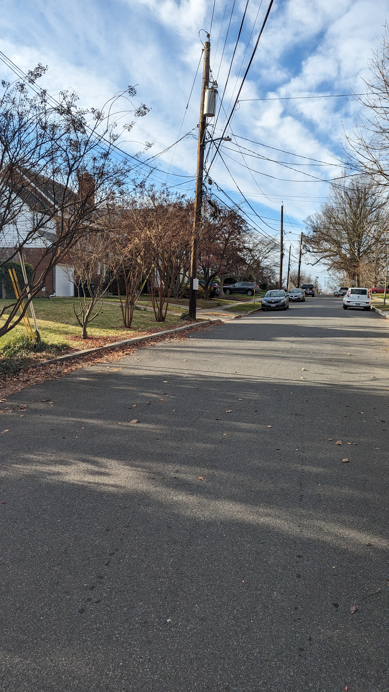
DISTRICT DEPARTMENT OF TRANSPORTATION
Aerial, Source: DC OCTO
Moreland Street NW Drainage Improvements Project
Welcome! Thank you for joining us. We will get started shortly.

Slide 2
DISTRICT DEPARTMENT OF TRANSPORTATION
Moreland Street NW Project Update
May 28, 2025
Notes:
Thank you for coming and thank you to our community stakeholders for providing feedback.

Slide 3
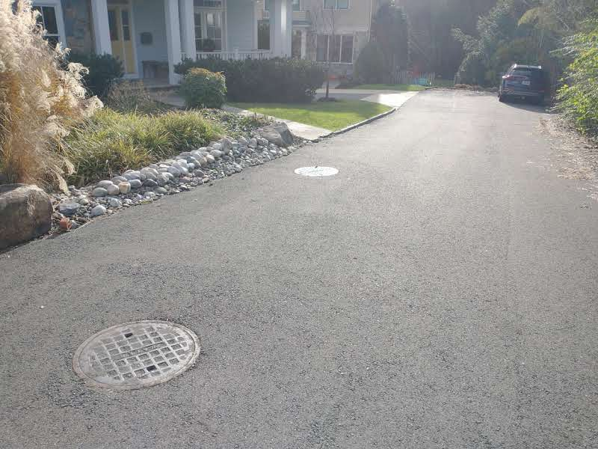
Meeting Agenda
Introductions
Purpose and Need
Design Update
Project Schedule
Feedback and Q&A
Moreland Street NW, Washington DC
Notes:
Update from previous meetings with 90% design

Slide 4
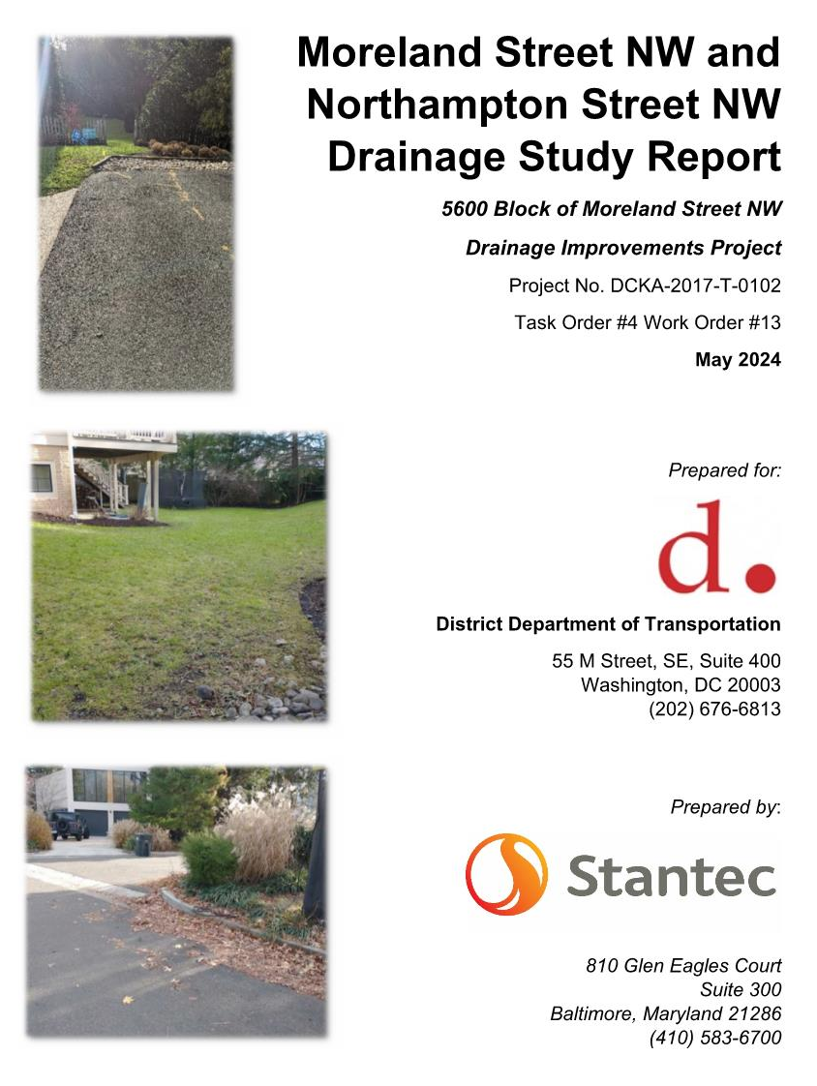
Purpose and Need
DDOT was contacted by residents with drainage concerns along the 5600 blook of Moreland Street NW 2023.
A drainage study was initiated in Fall 2023.
  This report recommended that new drainage infrastructure be constructed within DDOT right-of-way.
Based on the recommendations from the study, the design began in Spring 2024.

Slide 5
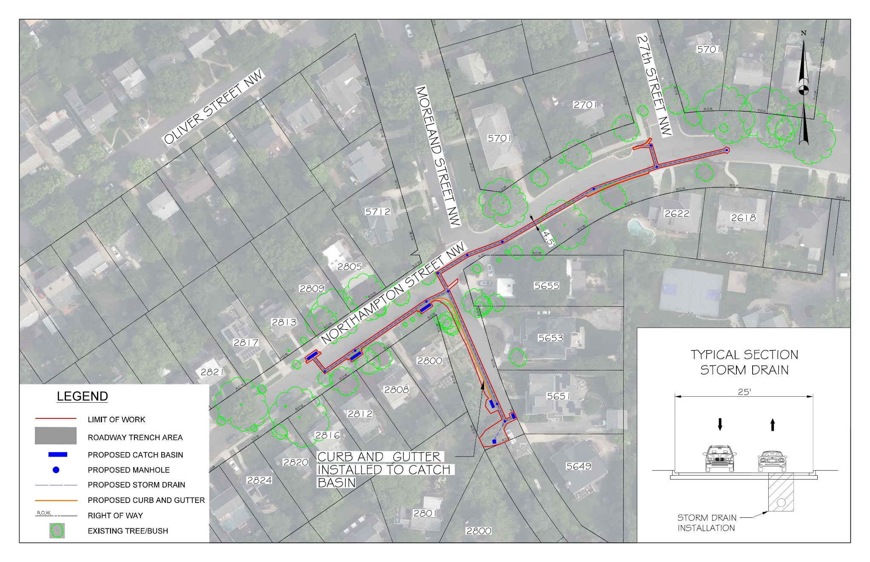
Moreland Street NW Project – 90% Design Project Overview
The key elements of the design:
Six drainage catch basins to capture runoff in DDOT right-of-way
New curb and gutter to direct flow to catch basins on Moreland Street NW
Notes:
Purpose of catch basins is to intercept runoff before leaving DDOT ROW. It will connect to an existing storm drain system on Northampton Street.
Northampton Street= 25 ft wide
Moreland Street= 17 ft wide

Slide 6
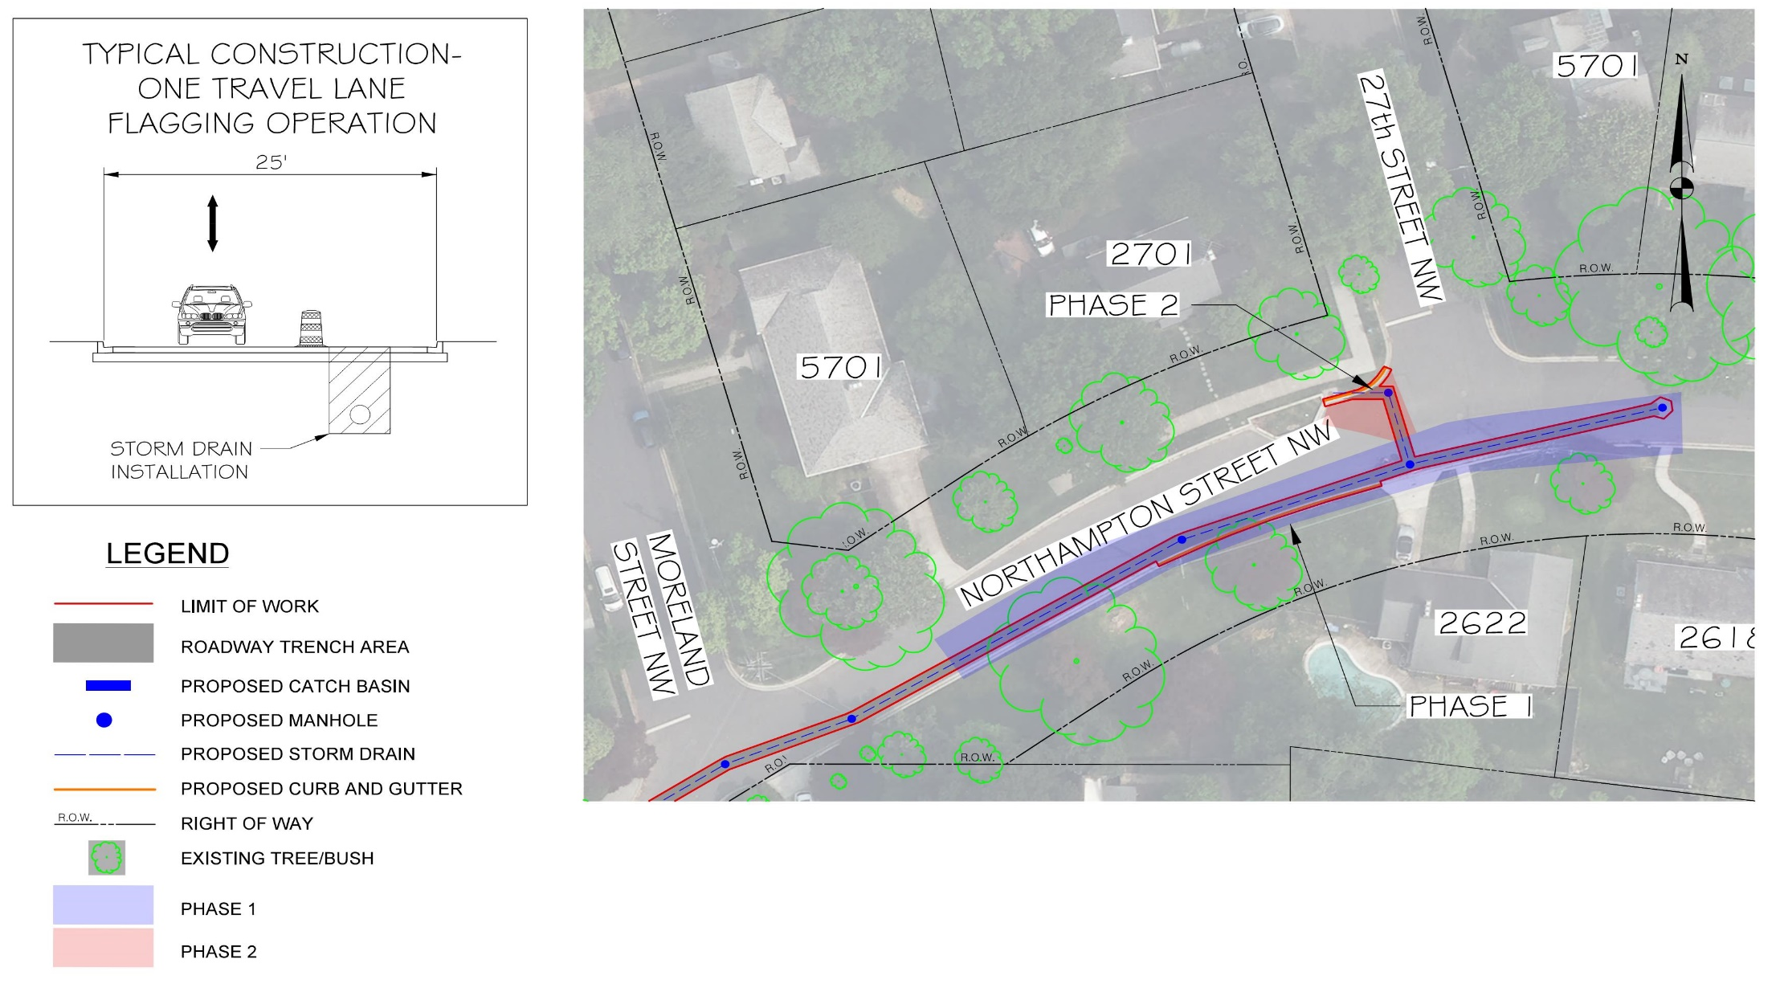
Moreland Street NW Project– Construction Phases 1 and 2
The key elements of the construction:
One travel lane will remain open with a flagging operation
Estimated duration (2 weeks for each phase)
Standard work hours: M-F, 7am – 7pm (Except holidays)
Notes:
Daily construction standard workhours expected: can be 7 am- 7 pm. DDOT and Contractor to coordinate with neighbors for daily/weekly anticipated access impacts?
No weekend of holiday work
Purpose of catch basins is to intercept runoff before leaving DDOT ROW. It will connect to an existing storm drain system on Northampton Street.
Northampton Street= 25 ft wide
Moreland Street= 17 ft wide

Slide 7
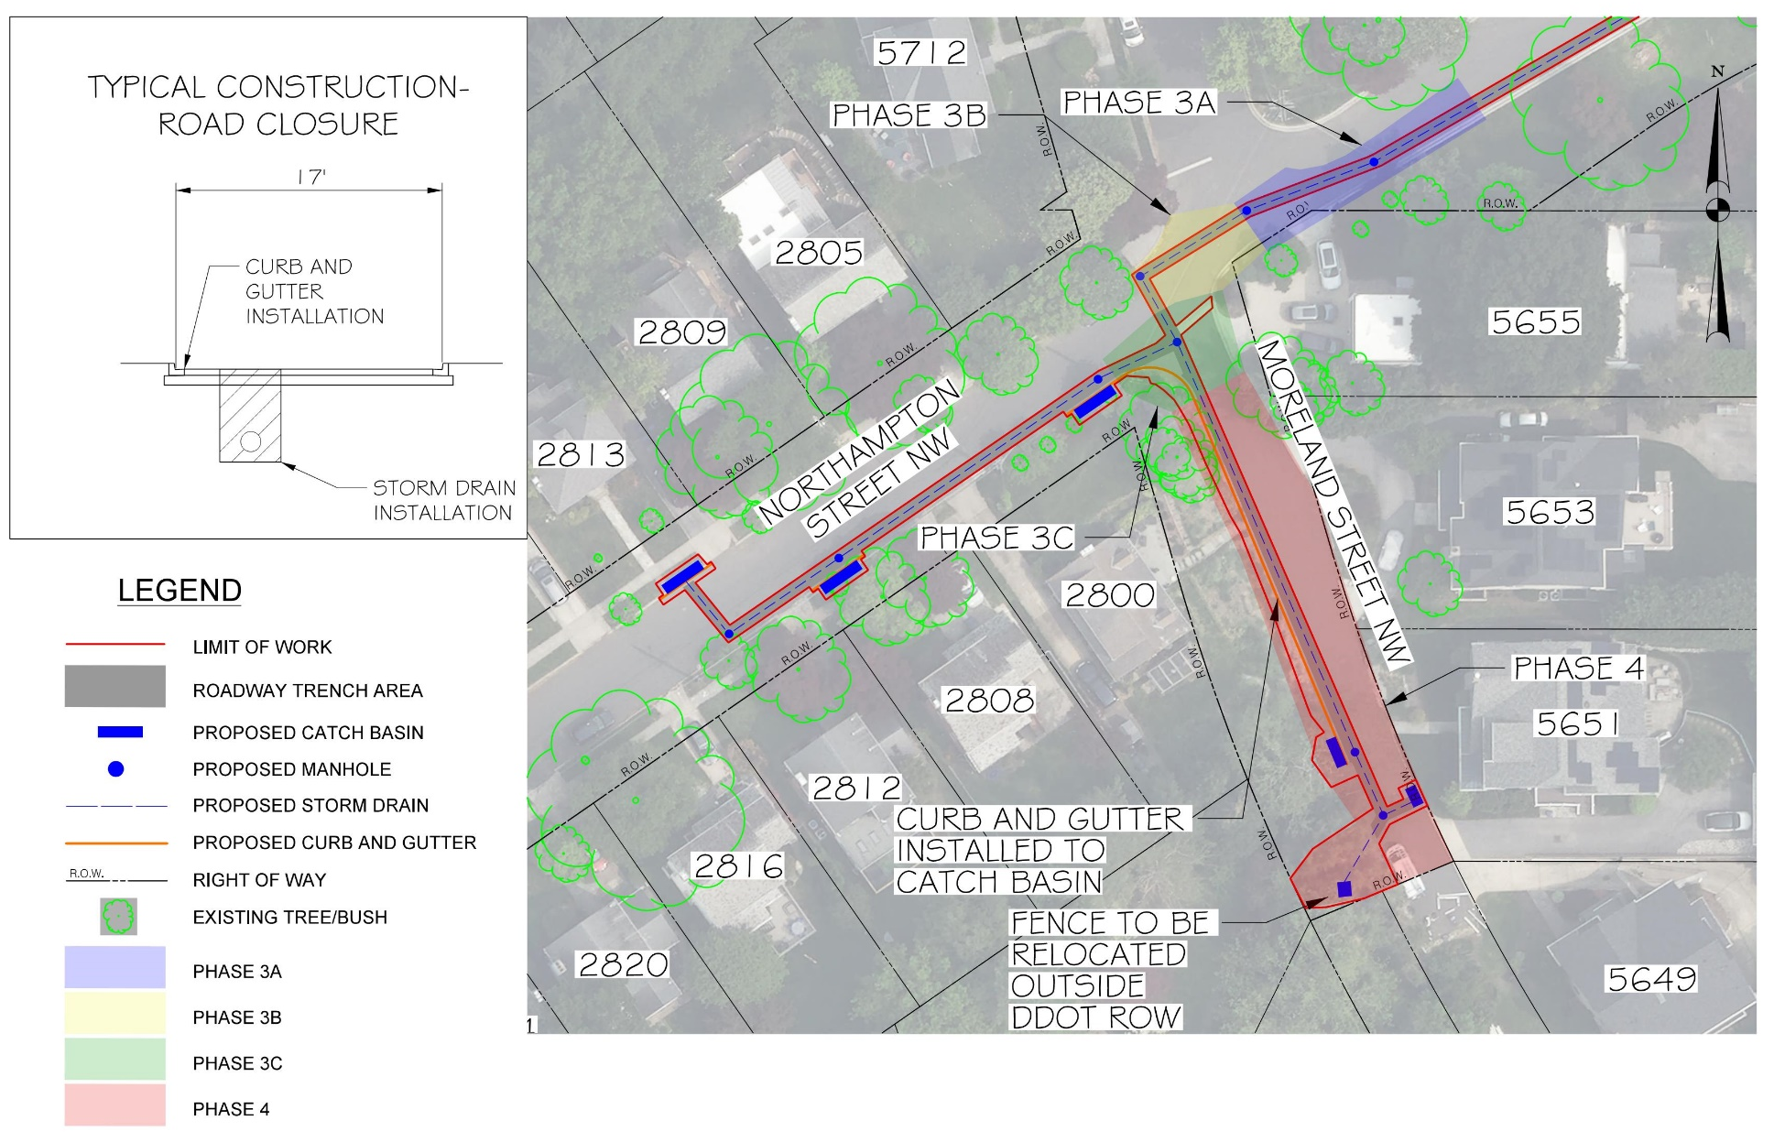
Moreland Street NW Project – Construction Phases 3A, 3B, 3C, and 4
The key elements of the construction:
One travel lane will remain open with a flagging operation for Phase 3A
Moreland Street NW will be closed to thru traffic during Phase 3B
  Daytime detour for Phase 3B
  Roadway will be open during Non-Working Hours
One travel lane will remain open on Northampton Street NW with a flagging operation for Phase 3C, Morland Street NW South of Phase 3C will be closed during this Phase
Moreland Street NW South of Phase 3C will be closed during Phase 4
Pedestrian access will be maintained during construction
Estimated duration (3 weeks each for phases 3A and 3C, 1 week for Phase 3B, and 4 weeks for phase 4)
Standard work hours: M-F, 7am – 7pm (Except holidays)
Coordination between Contractor/DDOT and affected residents during construction
Notes:
Daily construction standard workhours expected: can be 7 am- 7 pm. DDOT and Contractor to coordinate with neighbors for daily/weekly anticipated access impacts?
No weekend of holiday work
There is an impact to the tree located in front of 2808 Northampton St NW and a shrub (Crape Myrtle?) adjacent to 2800 Northampton St NW.
New curb and gutter will be installed on the west side of Moreland Street NW to control/direct the flow of run-off to new inlets I-3 and I-6. This work will impact some of the vegetation/plantings along the immediate edge of road in front of 2800 Northampton St NW.
At least a portion of the stand of bamboo will be removed across from 5651 Moreland Street NW to provide for installation/maintenance access of inlet I-6.
The fence encroachment around inlet I-6 will need to be removed/relocated onto private property (2800 McKinley Pl NW).
Trenching for new storm sewer pipe will be located within the roadway. However, trenching along Northampton Street NW will require replacement of a segment curb and gutter in front of 2622 Northampton Street NW.
Residents at 5655, 5653, 5651 and 5649 Moreland Street will not be able to drive to their homes during working hours for Phase 3B
Residents at 5653, 5651 and 5649 Moreland Street will not be able to drive to their homes during working hours for Phase 4
Purpose of catch basins is to intercept runoff before leaving DDOT ROW. It will connect to an existing storm drain system on Northampton Street.
Northampton Street= 25 ft wide
Moreland Street= 17 ft wide

Slide 8
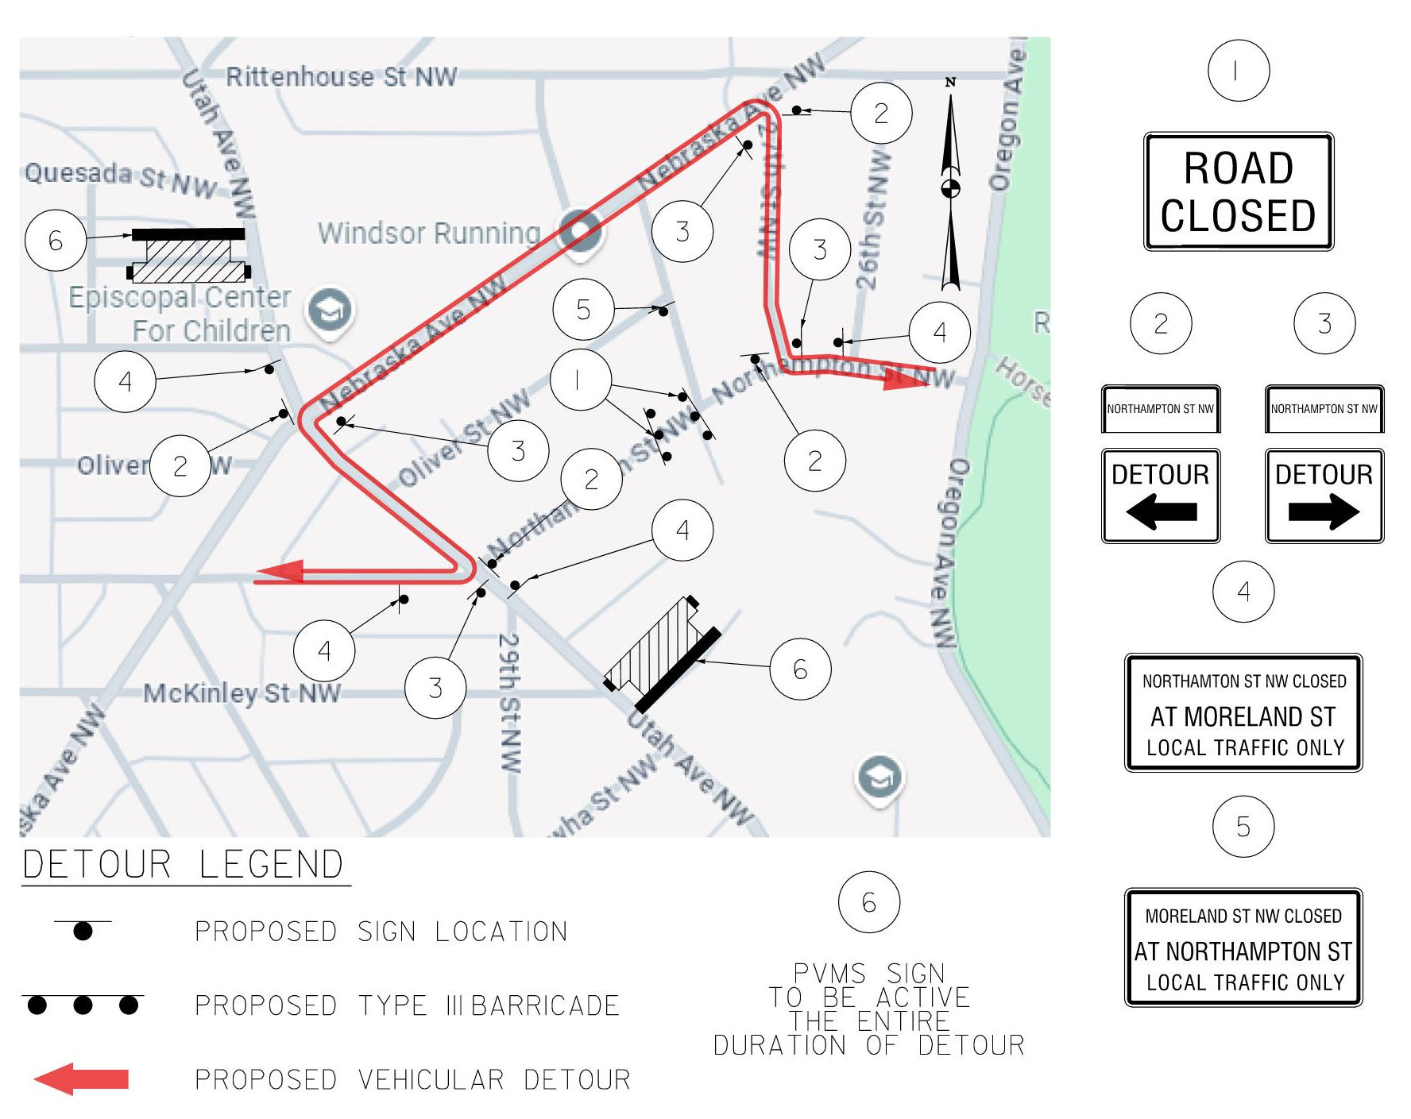
Moreland Street NW Project – Proposed Vehicular Detour
The key elements of the detour:
Detour will be active during phase 3B during working hours, M-F, 7am – 7pm (Except holidays)
Notes:
Daily construction standard workhours expected: can be 7 am- 7 pm. DDOT and Contractor to coordinate with neighbors for daily/weekly anticipated access impacts?
No weekend of holiday work
There is an impact to the tree located in front of 2808 Northampton St NW and a shrub (Crape Myrtle?) adjacent to 2800 Northampton St NW.
New curb and gutter will be installed on the west side of Moreland Street NW to control/direct the flow of run-off to new inlets I-3 and I-6. This work will impact some of the vegetation/plantings along the immediate edge of road in front of 2800 Northampton St NW.
At least a portion of the stand of bamboo will be removed across from 5651 Moreland Street NW to provide for installation/maintenance access of inlet I-6.
The fence encroachment around inlet I-6 will need to be removed/relocated onto private property (2800 McKinley Pl NW).
Trenching for new storm sewer pipe will be located within the roadway. However, trenching along Northampton Street NW will require replacement of a segment curb and gutter in front of 2622 Northampton Street NW.
Purpose of catch basins is to intercept runoff before leaving DDOT ROW. It will connect to an existing storm drain system on Northampton Street.
Northampton Street= 25 ft wide
Moreland Street= 17 ft wide

Slide 9
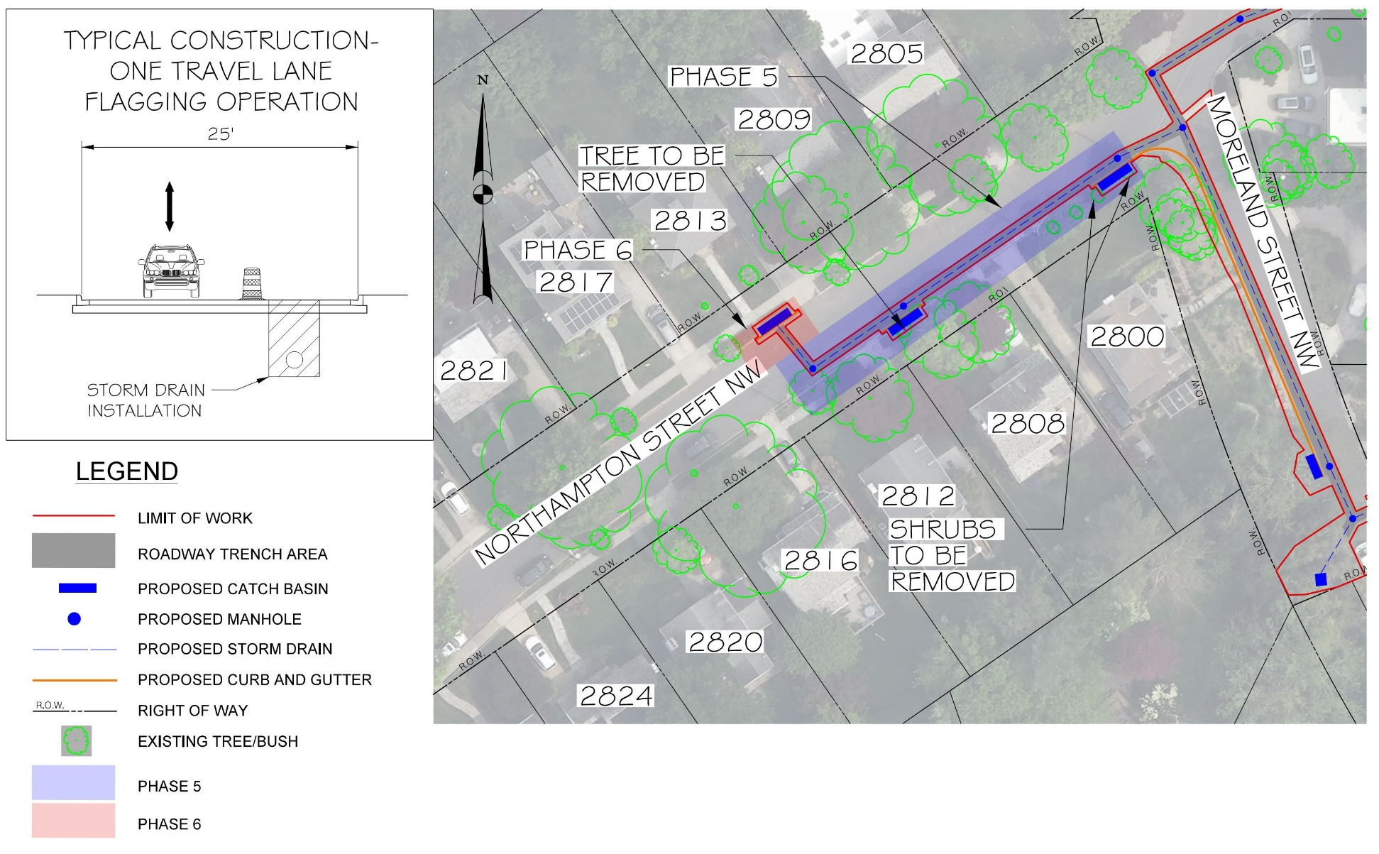
Moreland Street NW Project – Construction Phases 5 and 6
The key elements of the construction:
One travel lane will remain open with a flagging operation
Estimated duration (2 weeks for each phase)
Standard work hours: M-F, 7am – 7pm (Except holidays)
Notes:
Daily construction standard workhours expected: can be 7 am- 7 pm. DDOT and Contractor to coordinate with neighbors for daily/weekly anticipated access impacts?
No weekend of holiday work
Purpose of catch basins is to intercept runoff before leaving DDOT ROW. It will connect to an existing storm drain system on Northampton Street.
Northampton Street= 25 ft wide
Moreland Street= 17 ft wide

Slide 10
Project Timeline
Outreach
Outreach
2/26/2024 ANC Neighborhood Meeting–
Discussion of preliminary drainage study and community input
5/28/2025 Neighborhood Meeting–
Share 90% project design
Summer 2024
30% Design Complete
Fall 2024
65% Design Complete
Summer 2025
100% Design Complete
Fall 2025
Anticipated Construction Starts
6-8 months
Anticipated Construction Duration
Spring 2025
90% Design Complete
We are here
Notes:
6–8-month project, including utility relocations

Slide 11
Feedback Options
Morvarid Ganjalizadeh
morvarid.ganjalizadeh@dc.gov
202-904-3863
Bruce Sherman
3G02@anc.dc.gov
202-798-1420

Slide 12
Questions?

Slide 13

250 M St SE | Washington, DC 20003 | 202.673.6813

